Slide 1
Kisan Buddy Mahindra FarmEq
PIP2001 Capstone Project
Review-0
Batch Number: CSE-205
Roll Number | Student Name
20211CSE0884 | KAKARLA MANOJ KUMAR
20211CSE0164 | ALURU SIVA SAHITHI
20221LCS0005 | SHREYANK S
Under the Supervision of,
DR .Abdul Khadar A Associate Professor
School of Computer Science and Engineering
Presidency University
Name of the Program: B.TECH COMPUTER SCIENCE AND ENGINEERING [CSE]
Name of the HoD: DR.ASIF MOHAMMED H.B
Name of the Program Project Coordinator: MR.AMARNATH J.L
Name of the School Project Coordinators: Dr. Sampath A K / Dr. Abdul Khadar A / Mr. Md Ziaur Rahman

Slide 2
Content
Problem Statement
Github Link
Analysis of Problem Statement
Timeline of the Project
References

Slide 3
Problem Statement Number:
Organization: Mahindra(FarmEq )
Category : Software
Problem Description: Input to the app: Farmer's location, crops that he produces and their cost. This app gives the estimate of the nearest mandi where the farmer can sell his produce in his location . In addition to it, the app estimates the cost for each transaction and also displays the least cost transaction.
Difficulty Level: Simple

Slide 4
Github Link
Github Link
https://github.com/Manoj28012003/kissan-Buddy

Slide 5
Analysis of Problem Statement
Technology Stack Components:
Frontend(Framework/library)
Backend(Node.js with Express)
Database(PostgreSQL/MYSQL)
Security(Authentication/Data Encryption)
Cloud services(Hosting)

Slide 6
Analysis of Problem Statement (contd...)
Software requirments:
1. Mobile Application:
Operating Systems: Android, iOS
Development Frameworks: React Native, Flutter, or native development tools for Android (Java/Kotlin) and iOS (Swift/Objective-C).
Backend: Server-side technology to handle data processing, user management, etc. Common choices include Node.js, Python (Django/Flask), Ruby on Rails, Java (Spring), or PHP.
Database: SQL databases (MySQL, PostgreSQL) or NoSQL databases (MongoDB, Firebase).
2. Web Application:
Frontend: HTML, CSS, JavaScript, and frameworks like Angular, React, or Vue.js.
Backend: Similar to the mobile application, using technologies like Node.js, Django, or Ruby on Rails.
Database: Same options as for the mobile app.

Slide 7
Analysis of Problem Statement (contd...)
APIs:
Weather Data: Integration with weather data providers (e.g., OpenWeatherMap, Weatherstack).
Market Prices: APIs to fetch agricultural commodity prices.
GPS Services: For location-based services and mapping (e.g., Google Maps API).
4. Data Analytics and Machine Learning:
Tools: TensorFlow, Scikit-learn, or other machine learning libraries for predictive analytics.
Analytics Platforms: Google Analytics, Mixpanel for user behavior insights.

Slide 8
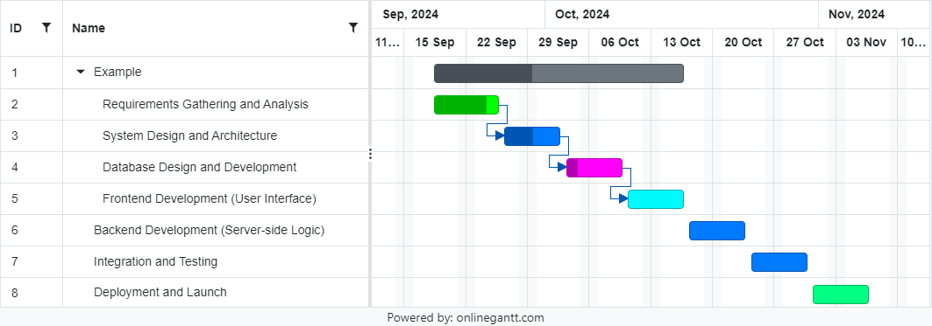
Timeline of the Project (Gantt Chart)

Slide 9
References (IEEE Paper format)
https://ieeexplore-ieee-org-presiuniv.knimbus.com/document/10271389
https://ieeexplore.ieee.org/document/8978315
https://ijisrt.com/wp-content/uploads/2018/03/Android-Application-for-Crop-Yield-Prediction-and-Crop-Disease-Detection-Copy-1.pdf

Slide 10


